Slide 1
2020 Year in Review Urban Housing Lab
A4 FLYER
TEMPLATE
I am extremely proud of our collective efforts and achievements this year. Despite the challenges of remote teaching; home schooling; social isolation; and separation from overseas and interstate family, Urban Housing Lab researchers continued to produce important work and contribute to wider policy development and public debate. This included advice, analysis, and research on implications of the COVID-19 Pandemic for housing and cities, through media commentary; podcasts; and research publication.
Together, Urban Housing Lab members:
Led and collaborated on 10 significant research reports, including 2 on housing and the Covid-19 Pandemic
Commenced and continued work on 13 externally funded research projects, and were successful in winning an additional 4 research grants to begin in 2021
Published more than 45 journal articles and 19 book chapters
Participated in numerous public talks and events, and were widely cited by television, radio, and print media
Message from Urban Housing Lab Co-Founder
Professor Nicole Gurran
About the Urban Housing Lab:
The Urban Housing Lab brings a cross disciplinary perspective to the critical problems facing cities and regions. We are a diverse group of planners, geographers, data scientists and economists with particular expertise in housing, health, transport, infrastructure, digital transformations and urban governance. Initially funded by the Halloran Trust in 2015 as a research Incubator, and established by Professor Nicole Gurran (urban policy and housing) and Dr Somwrita Sarkar (complex networks, computational models), the Urban Housing Lab has grown to include more than 15 core researchers within the Sydney School of Architecture, Design and Planning, including post doctoral scholars and research students, as well as many visiting scholars and practitioners in residence. We share a strong social justice commitment and seek to inform public debate, influence policy change, and improve urban and housing outcomes through our research and wider engagement.
New members and appointments:
The Urban Housing Lab continued to grow in 2020, and we were thrilled to welcome three new post doctoral researchers; Dr Caitlin Buckle, Dr Rebecca Clements and Dr Zahra Nasreen. In addition, Dr Pranita Shrestha was appointed to a three year post doctoral position.

Slide 2
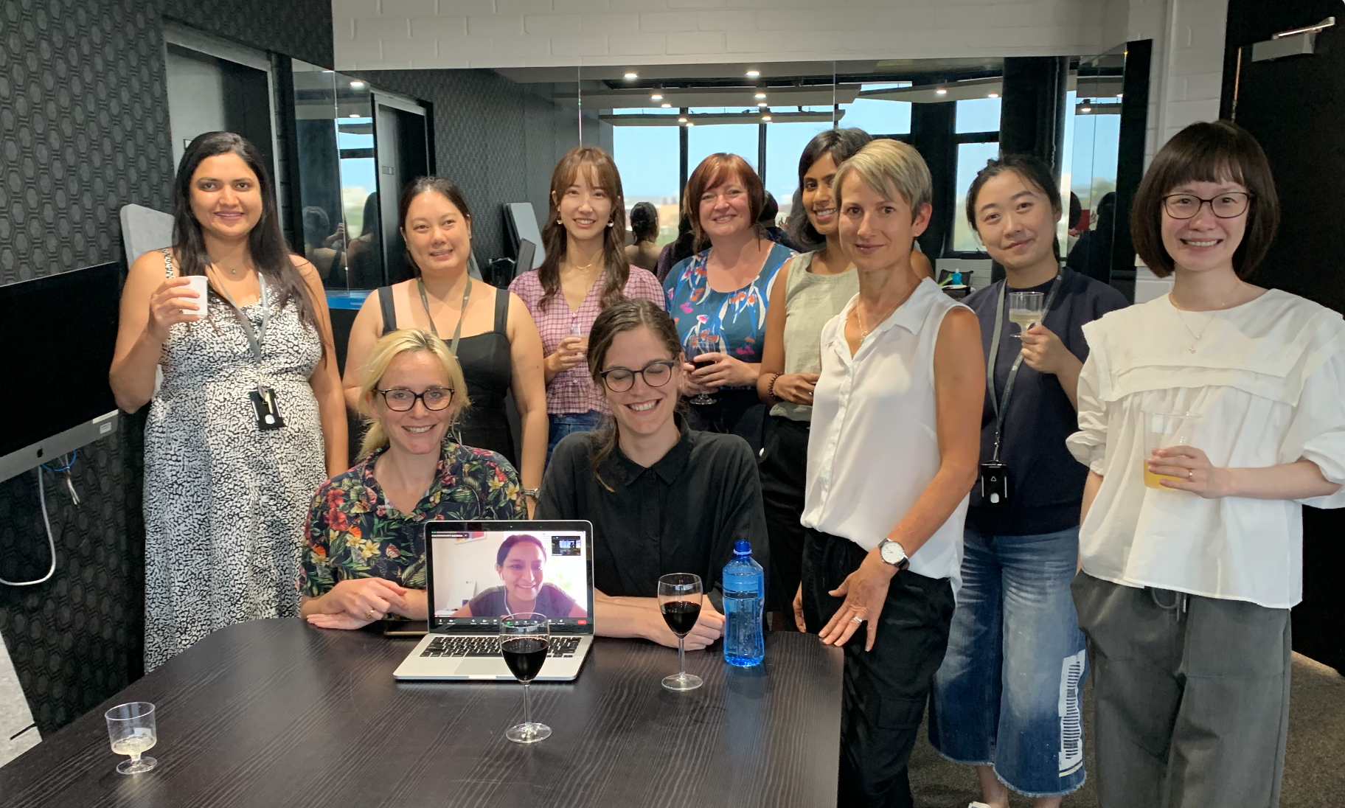
A4 FLYER
TEMPLATE
Spotlight on our Early Career Researchers:
Development of the Early Career Urban Researchers group:
A fundamental aim of the Urban Housing Lab is to support early career researchers (ECRs). We have an active and talented group of urbanistas, either still working through the PhD task or just starting to launch an academic career. While enforced segregation isn’t usually a catalyst for collaboration, the COVID lock-down actually proved to be a great stimulus for our ECRs to get together and share their triumphs and tribulations – both personal and professional. The newly created ECUR group (Early Career Urban Researchers) met once a fortnight throughout most of 2020, often to be inspired by presentations from more senior urban researchers from around Australia. The group kicked off 2021 in February with a strategic planning afternoon, and plans to continue to meet fortnightly – for the first time face to face. Message from ECUR Organiser Dr Jennifer Kent
.
Photo of first ever face-to-face ECUR get together
Clockwise from left: Dr Zahra Nasreen, Laura Goh, Dr Yuan Wei, Dr Rebecca Clements, Deepti Prasad, Dr Jennifer Kent, Xiao Ma, Dr Sha Liu, Dr Caitlin Buckle, Dr Pranita Shrestha (via Zoom) and Dr Sophia Maalsen
Key Achievements from our ECRs in 2020 :
A number of ECRs reached milestones in 2020 amongst the many difficulties that the year of COVID-19 presented.
First journal article published:
Deepti Prasad
Prasad, D., Alizadeh, T. (2020). What Makes Indian Cities Smart? A Policy Analysis of Smart Cities Mission. Telematics and Informatics, 55 (2020), 101466. [More Information]
First time leading a competitively funded-project:
Dr Caitlin Buckle
Informal, marginal, and short-term accommodation under Covid-19: housing system risks and opportunities, Buckle C, Gurran N, Phibbs P, Harris P, Lea T, Shrivastava, R Australian Housing and Urban Research Institute Ltd/AHURI Project Grants

Slide 3
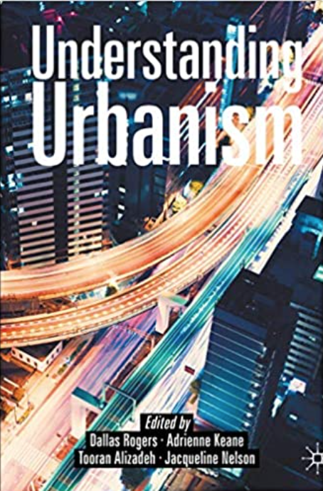
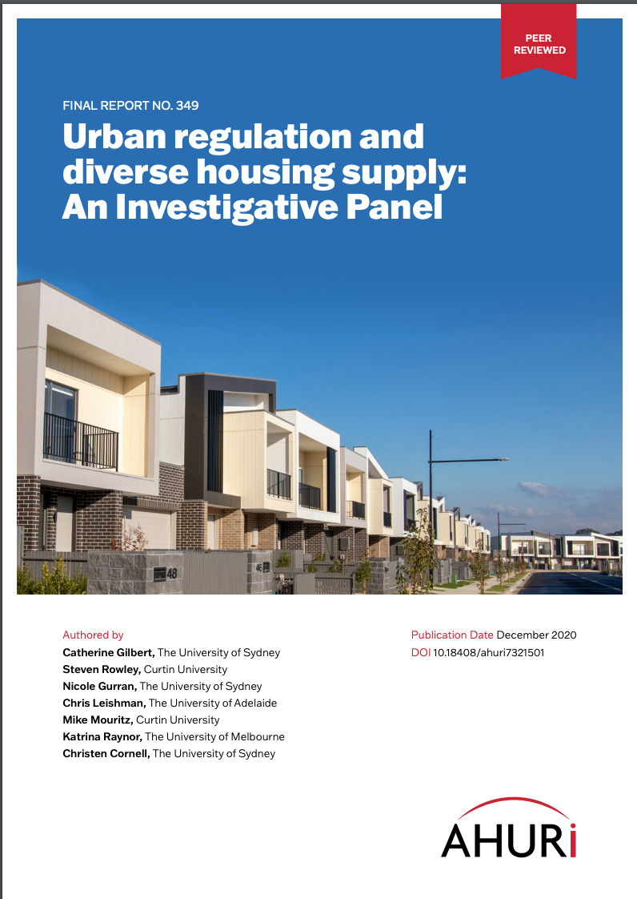
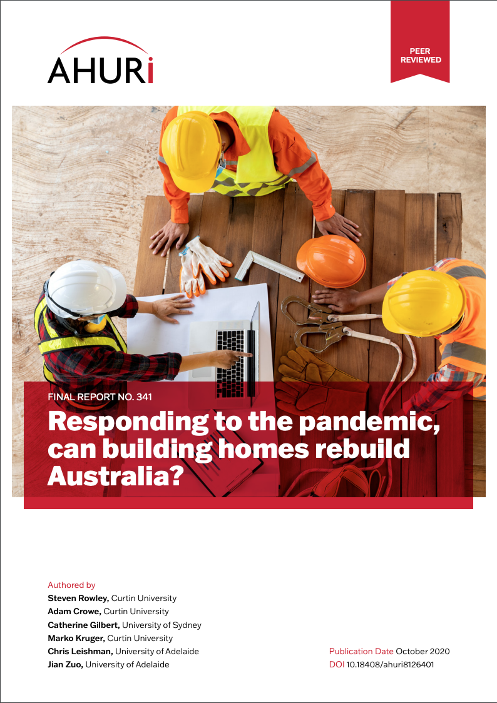
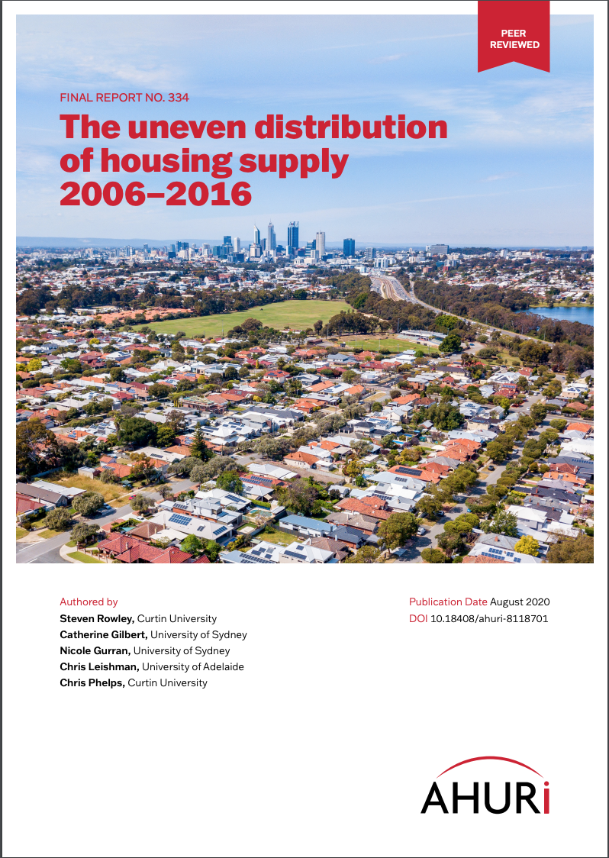
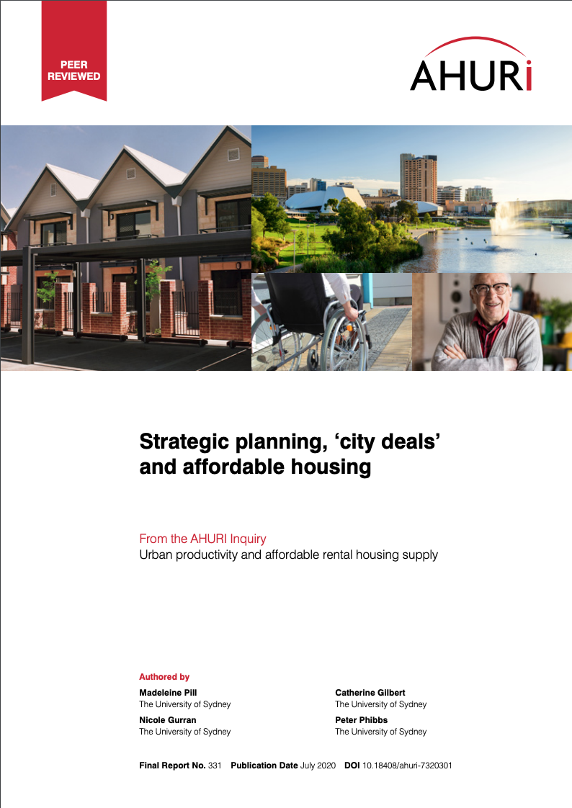
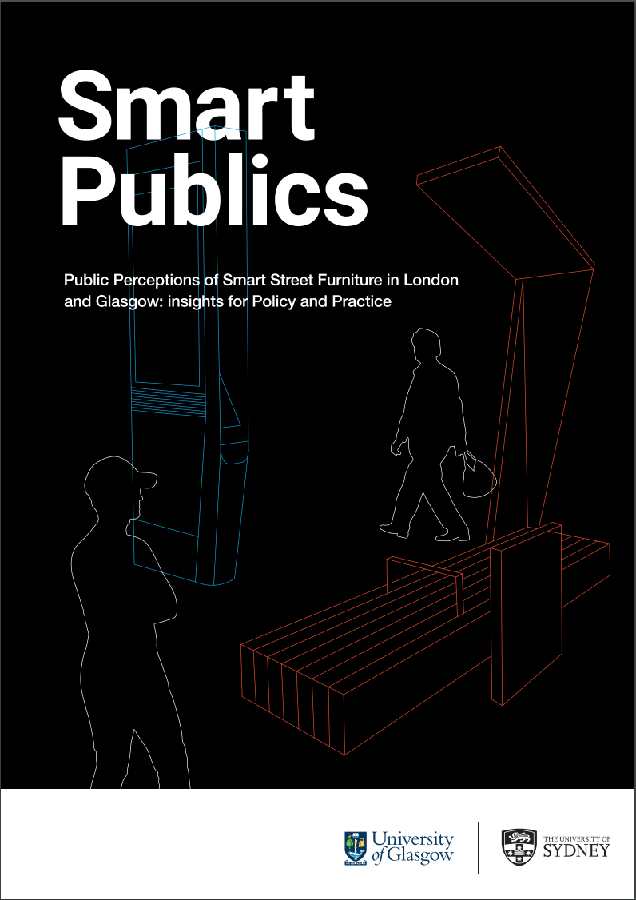
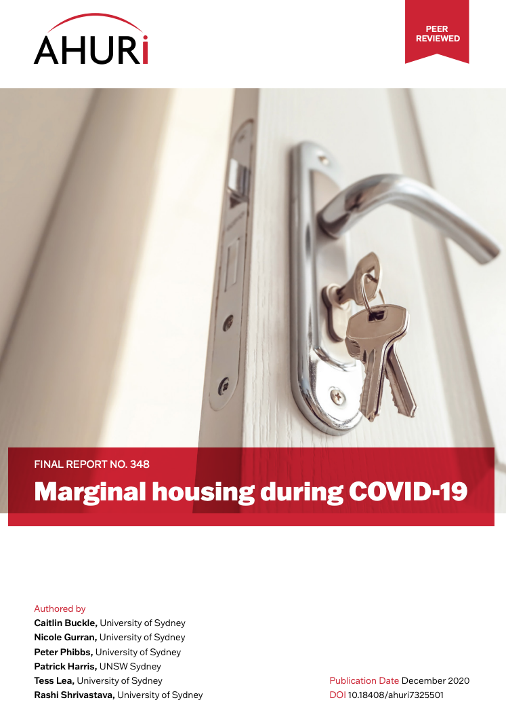
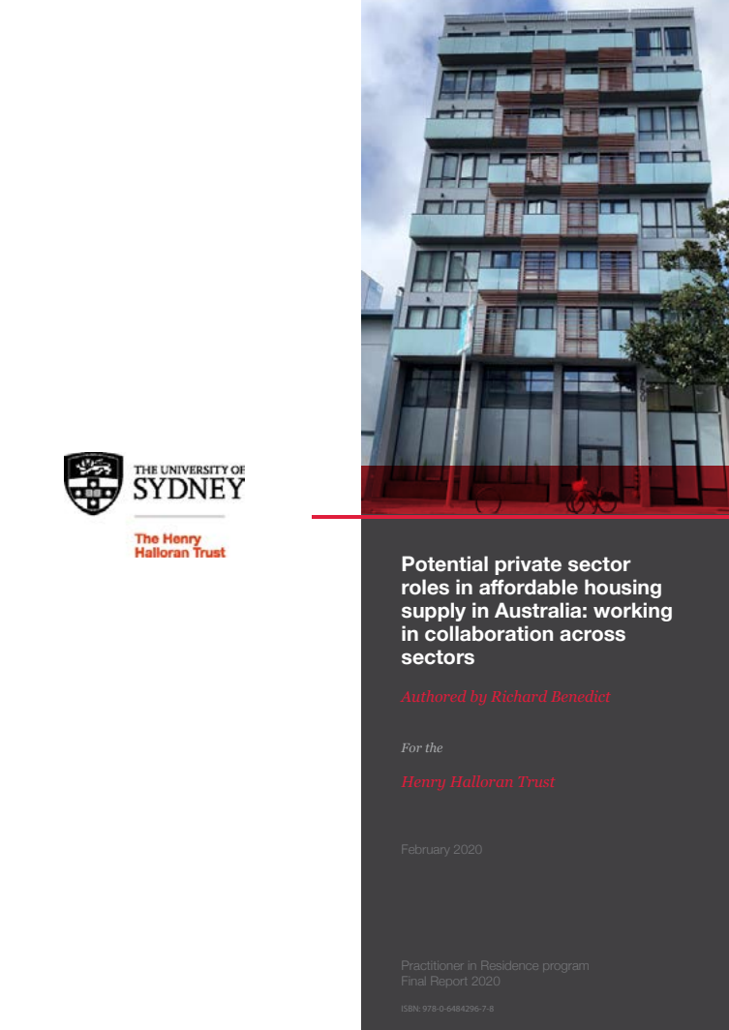
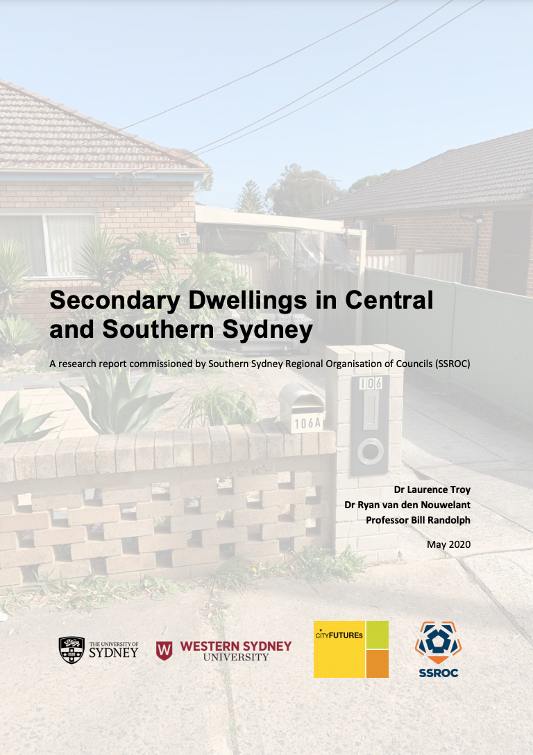
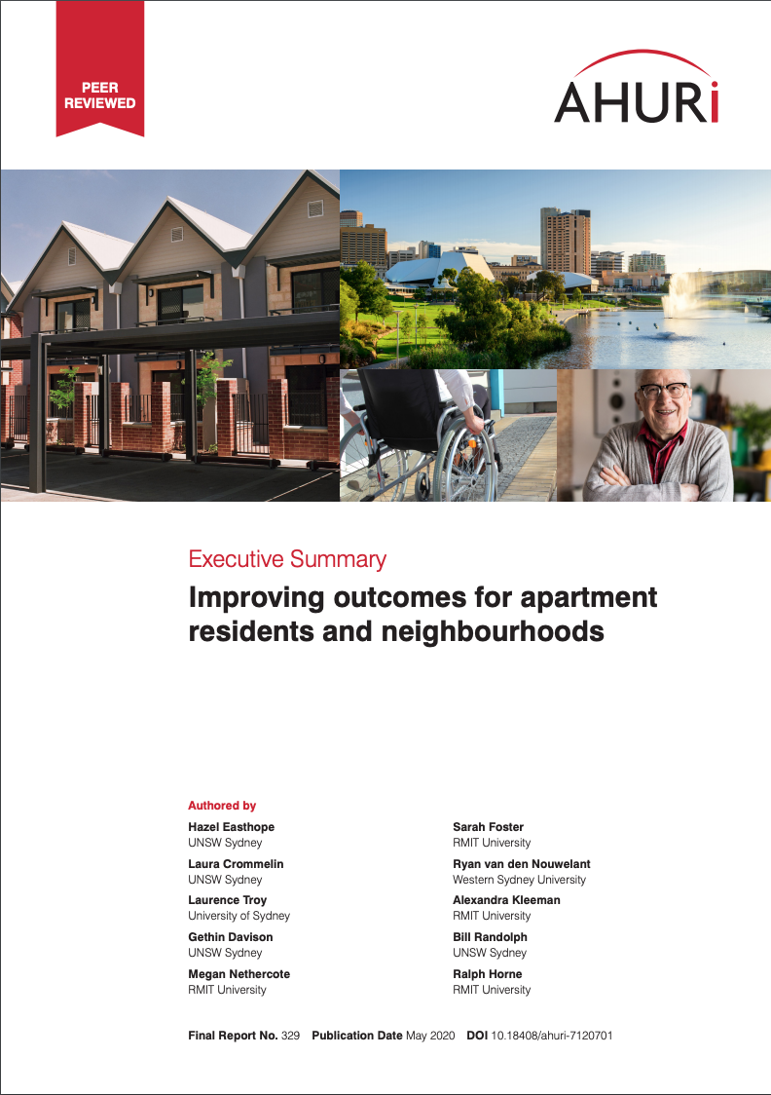
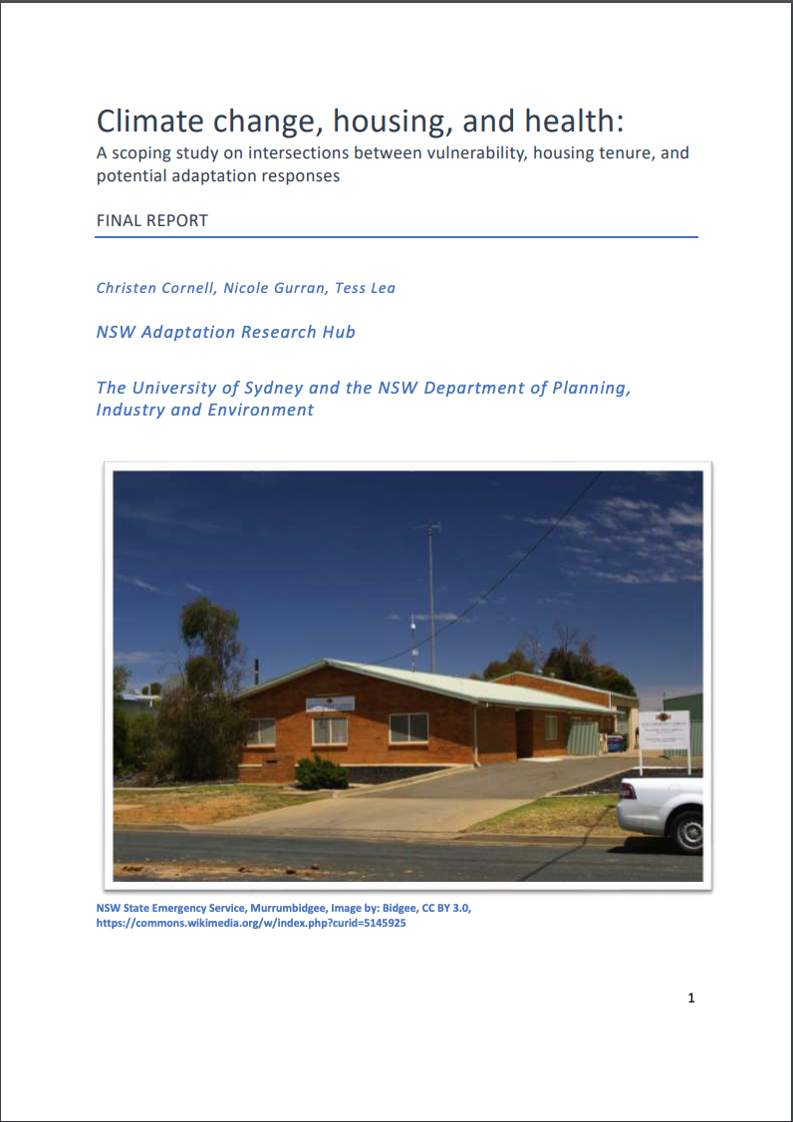
2020 Year in Review Urban Housing Lab
A4 FLYER
TEMPLATE
Major Publications:
Lab members led and collaborated on a number of important research publications this year dealing with housing and the COVID-19 Pandemic; affordable housing supply; apartment design, climate change, and health.
Understanding Urbanism
Urban regulation and diverse housing supply
Responding to the pandemic, can building homes rebuild Australia?
The uneven distribution of housing supply 2006-2016
Strategic planning, ‘city deals’ and affordable housing
Smart Publics
Marginal housing during COVID-19
Potential private sector roles in affordable housing supply in Australia
Secondary Dwellings in Central and Southern Sydney
Improving outcomes for apartment residents and neighbourhoods
Climate change, housing and health

Slide 4
2020 Year in Review Urban Housing Lab
A4 FLYER
TEMPLATE
Research Projects Commenced in 2020:
Affordable Rental Housing Development under the State Environmental Planning Policy (Affordable Rental Housing) 2009-2019, Gilbert C, Liu S, Gurran N, The Community Housing Industry Association NSW
Hacking Housing: Technologies, processes and practices of housing futures, Maalsen S, Australian Research Council (ARC)/Discovery Early Career Researcher Award (DECRA)
Hidden housing crisis? Urban planning and informal housing supply, Gurran N, Australian Research Council (ARC)/Discovery Projects (DP)
Housing key workers: scoping challenges, aspirations and policy responses for Australian cities, Gilbert C, Zhang Y, Gurran N, Australian Housing and Urban Research Institute Ltd/National Housing Research Program - Research Projects
Informal, marginal, and short-term accommodation under Covid-19: housing system risks and opportunities, Buckle C, Gurran N, Phibbs P, Harris P, Lea T, Shrivastava, R Australian Housing and Urban Research Institute Ltd/AHURI Project Grants
Infrastructure Governance Incubator: From Strategic Planning to Project Delivery, Alizadeh T, Searle G, The Henry Halloran Trust/Incubator
Innovating urban governance: practices for enhanced urban futures, McGuirk P, Dowling R, Maalsen S, Baker T, Australian Research Council (ARC)/Discovery Projects (DP)
Measuring neighbourhood change through residential mobility and employment, Sarkar S, Gurran N, Shrivastava, R Australian Housing and Urban Research Institute Ltd/Research Grant
New Housing Supply, Population Growth, and Accessibility to Social Infrastructure Sarkar, S., Levinson, D., Moylan, E., Gurran, N., AHURI Standalone Data Project
Parenting and the Private Car, Kent J, Australian Research Council (ARC)/Discovery Early Career Researcher Award (DECRA)
Resilience of the short-term rental sector to extreme events, Buckle C, The Henry Halloran Trust/Festival of Urbanism Research Grant
Trust and Safety in Autonomous Mobility Systems: A Human-centred Approach, Tomitsch M, Hespanhol L, Worrall S, Nebot E, Kent J, Wiethoff A, Ellison A, Australian Research Council (ARC)/Discovery Projects (DP)
Understanding discrimination effects in private rental housing, Maalsen S, Rogers D, Australian Housing and Urban Research Institute Ltd/National Housing Research Program - Research Projects
Forthcoming in 2021:
Inequality in Australia: Housing in the Asset Society, Konings M, Adkins L, Rogers D, Australian Research Council (ARC)/Special Research Initiative: Australian Society, History and Culture
The precarious city: the suburban settlement in an age of uncertainty, Troy L, Randolph B, Australian Research Council (ARC) Discovery Project 2021
Pathways to home ownership in an age of uncertainty, Troy L, Adkins L, Konnings M, Bryant G, Buckle C, Buckley A, Australian Housing and Research Institute (AHURI)
Private sector involvement in social and affordable housing, Gurran, N, Rowley, S, Benedict R, Gilbert, C, Hamilton C, Liu S Australian Housing and Research Institute (AHURI)

Slide 5
2020 Year in Review Urban Housing Lab
A4 FLYER
TEMPLATE
Despite the disruptions to key events and conferences through 2020 due to the pandemic, UHL members were involved with many virtual events throughout the year.
Key Events:
12th June | Panel with some of Sydney’s leading urbanists A Conversation on Post-Pandemic Urbanism: Prospects for a Just Urban Recovery? organized by UHL’s Dr Sophia Maalsen with Professor Robyn Dowling (USyd) Professor Pauline McGuirk (UOW) and Tom Baker (UoN) featuring UHL’s Dr Jennifer Kent
10–25th August | Professor Nicole Gurran and Dr Somwrita Sarkar hosted a Big Data and Neighborhood Change Virtual Symposium in collaboration with Professor Karen Chapple from University of California, Berkeley
2nd September | Professor Nicole Gurran was invited to make the Annual Henry George Commemorative Address
23rd October | Understanding Urbanism, a textbook edited by UHL members Dr Dallas Rogers and Associate Professor Tooran Alizadeh, with Adrienne Keane and Jacqueline Nelson, was launched this year. With contributions from other UHL members Dr Jennifer Kent, Dr Glen Searle and Dr Somwrita Sarkar.
13–26th November | The Festival of Urbanism showcased many of the UHL research work, with Q&A sessions, workshops, panel discussions and presentations of research results

Slide 6
A4 FLYER
TEMPLATE
UHL Members in the Media:
Associate Professor Tooran Alizadeh was interviewed and featured in the ABC TV’s 7:30 program re the NBN upgrade announced in a joined media release by the Minister for Communications, Cyber Safety, and the Arts and also the Minister for Finance. Tooran was also quoted in The New Daily and interviewed on Statewide Drive - ABC Radio re the NBN upgrade and Radio Reversal 4zzz on the ups and downs of the NBN with special reference to the implications during COVID normal times.
Dr Caitlin Buckle was interviewed on Radio Adelaide and ABC Radio on Saturday Afternoon with Shelley Ware to discuss findings of the Marginal Housing during COVID-19 report in December. The report was referenced in Domain and ABC newspaper articles. Caitlin was also interviewed on the Housing Journal Podcast by Dr Dallas Rogers discussing her essay on conducting research during COVID-19.
Professor Nicole Gurran was quoted in various newspaper articles throughout the year, discussing eviction moratoriums during COVID-19 in Domain, ABC News and The New Daily, zoning restrictions in Domain, sustainable urban communities in The Urban Developer, social housing in Domain, rental assistance in Domain, private landlords and social housing in Domain, urban density in 9News, city deals in Government News and public space in The Sydney Morning Herald.
Dr Sophia Maalsen and Dr Laurence Troy spoke on ABC Radio National Big Ideas on being a life-long renter and not a home-owner. Sophia was also quoted in The Sydney Morning Herald on share housing during COVID-19, and Laurence was also quoted in The New Daily speaking about social and affordable housing provision.
Dr Dallas Rogers was quoted in In Daily discussing the impact of COVID-19 on the perceptions of housing, and on public housing in ABC News. Dallas also produced Citizens and urban planning and Montesquieu and despotism, radio features for ABC Radio National’s The Philosophers Zone.
Conversation Pieces:
What did COVID do to rental markets? Buckle, C., Gurran, N., Harris, P., Phibbs, P., Shrivastava, R., Lea, T.
Quality of life in high-density apartments varies. Here are 6 ways to improve it Easthope, H., Crommelin, L., Troy, L., Nethercote, M.
Homelessness and overcrowding expose us all to coronavirus Gurran, N., Phibbs, P., Lea, T.
Who’s most affected on public transport in the time of coronavirus? Kent, J., Delbosc, A., McCarthy, L.
Why housing evictions must be suspended to defend us against coronavirus Maalsen, S., Martin, C., Rogers, D., Power, E.
Public housing ‘renewal’ likely to drive shift to private renters, not owners, in Sydney Rogers, D., Darcy, M.
Public housing renewal can make tenants feel displaced in their home, even before any work begins Rogers, D., Wynne, L.
Why more housing stimulus will be needed to sustain recovery Rowley, S., Crowe, A., Gilbert, C., Kruger, M., Leishman, C., Zuo, J.
Will the population freeze allow our big cities to catch up on infrastructure? Searle, G., Legacy, C.
To contact the Urban Housing Lab:
Professor Nicole Gurran | Director
T +61 2 9351 7729| E nicole.gurran@sydney.edu.au

Slide 7
2020 Year in Review Urban Housing Lab
A4 FLYER
TEMPLATE
Journal Articles Published in 2020:
Alizadeh, T., Grubesic, T., Helderop, E. (2020). Socio-spatial patterns of the National Broadband Network revealed: Lessons from Greater Sydney, Melbourne, and Brisbane. Telecommunications Policy, 44 (5, June 2020), 101941. [More Information]
Alizadeh, T., Sadowski, J. (2020). Smart urbanism: Processes, practices, and parameters. Telematics and Informatics, 55. [More Information]
Baker, E., Rogers, D., at al. (2020). Rental Insights A COVID-19 Collection. Australian Housing and Urban Research Institute (AHURI) [More Information]
Buckle, C. (2020). Touching, scrolling and swooping: Performing and representing migrant stories through geospatial technologies. Geoforum, 111, 83-93. [More Information]
Buckle, C. (2020). Migrants' encounters of a lifestyle destination: From coastal idyll to activated city. Geographical Research. [More Information]
Dowling, R., Maalsen, S. (2020). Familial mobilities beyond the private car: electric bikes and car sharing in Sydney, Australia. Applied Mobilities, 5(1), 53-67. [More Information]
Druta, O, Rogers, D, and Power, E (2020) Holiday reading list for a post-COVID-19 housing system. International Journal of Housing Policy 20 (4), 467-473 [More Information]
Easthope, H., Power, E., Rogers, D., and Dufty-Jones, R. (2020) Thinking relationally about housing and home. Housing Studies 35 (9), 1493-1500 [More Information]
Easthope, H., Crommelin, L., Troy, L., Randolph, B. (2020). A new pathway to displacement? The implications of less-than-unanimous strata renewal laws for vulnerable residents. Australian Planner. [More Information]
Gilbert, C., Gurran, N. (2020). Planning for Diverse and Affordable Housing Supply? A Survey of 200 Australian Planning Schemes. Journal of Planning Education and Research, online (in press). [More Information]
Gurran, N., Zhang, Y., Shrestha, P. (2020). 'Pop-up' tourism or 'invasion'? Airbnb in coastal Australia. Annals of Tourism Research, 81, 1-17. [More Information]
Gurran, N., Maalsen, S., Shrestha, P. (2020). Is 'informal' housing an affordability solution for expensive cities? Evidence from Sydney, Australia. International Journal of Housing Policy. [More Information]
Harris, P., Kent, J., Sainsbury, P., Riley, E., Sharma, N., Harris, E. (2020). Healthy urban planning: an institutional policy analysis of strategic planning in Sydney, Australia. Health Promotion International, 35(4), 649-660. [More Information]
Iveson, K., Blatman-Thomas, N., Chatterjee, P., Sisson, A., Rogers, D. (2020) The New Enclosure: The Appropriation of Public Land in Neoliberal Britain (Book Forum). Dialogues in Human Geography 10 (1), 61-65
Kent, J., Mulley, C., Stevens, N. (2020). Challenging policies that prohibit public transport use: Travelling with pets as a case study. Transport Policy, 99, 86-94. [More Information]
Kinsley, S., McLean, J. and Maalsen, S. (2020) Editorial, Digital Geography and Society, [More Information]
Lobo, M., Duffy, M., Witcomb, A., Brennan-Horley, C., Kelly, D., Barry, K., Bissell, D., Buckle, C., Cretney, R., Harada, T., et al (2020). Practising lively geographies in the city: encountering Melbourne through experimental field-based workshops. Journal of Geography in Higher Education, 44(3), 406-426. [More Information]
Maalsen, S. (2020). 'Generation Share': digitalized geographies of shared housing. Social and Cultural Geography, 21(1), 105-113. [More Information]
Maalsen, S. (2020). Revising the Smart House as Assemblage. Housing Studies, 35(9), 1534-1549. [More Information]
Maalsen, S., Dowling, R., (2020). Covid-19 and the accelerating smart home. Big Data & Society, 7(2), 1-5. [More Information]
Maalsen, S., Rogers, D., & Ross, L. P. (2020). Rent and crisis: Old housing problems require a new state of exception in Australia. Dialogues in Human Geography, 10(2), 225–229. [More Information]
McAuliffe, C., Rogers, D. (2020) Value pluralism in urban planning. Planning Theory 19 (2), 242-248 [More Information]
Paine, G., Thompson, S., Prior, J., Connon, I., & Kent, J. L. (2020). Bringing History Forward: Learning from Historical Context when Translating Contemporary Health Evidence into Planning Practice. Journal of Planning History. [More Information]
Perng, S., Maalsen, S. (2020). Civic Infrastructure and the Appropriation of the Corporate Smart City. Annals of the American Association of Geographers, 110(2), 507-515. [More Information]
Pinnegar, S., Randolph, B., Troy, L. (2020). Decoupling Growth from Growth-dependent Planning Paradigms: Contesting Prevailing Urban Renewal Futures in Sydney, Australia. Urban Policy and Research, 38(4), 321-337. [More Information]
Power, E.R, Rogers, D., Kadi J. (2020) Public housing and COVID-19: contestation, challenge and change. International Journal of Housing Policy 20 (3), 313-319 [More Information]
Prasad, D., Alizadeh, T. (2020). What Makes Indian Cities Smart? A Policy Analysis of Smart Cities Mission. Telematics and Informatics, 55 (2020), 101466. [More Information]
Rogers, D. (2020) Australia’s Metropolitan Imperative: An Agenda for Governance Reform (Book Forum). Australian Geographer 51 (1), 127-129 [More Information]
Rogers, D., Gibson, C (2020) Unsolicited urbanism: development monopolies, regulatory-technical fixes and planning-as-deal-making. Environment and Planning A: Economy and Space. [More Information]
Rogers, D., Herbert, M. (2020). Podcasts and Urban Studies: Notes from the Field; Sounds from the Studio. Urban Policy and Research, 38(1), 63-73. [More Information]
Rogers, D., Herbert, M., Whitzman, C., McCann, E., Maginn, P., Watts, B., Alam, A., Pill, M., Keil, R., Dreher, T., Alizadeh, T., et al (2020). The city under Covid-19: podcasting as digital methodology. Tijdschrift voor Economische en Sociale Geografie, 111(3), 434-450. [More Information]
Rogers, D., Power, E. (2020) Housing policy and the COVID-19 pandemic: the importance of housing research during this health emergency. International Journal of Housing Policy 20 (2), 177-183 [More Information]

Slide 8
2020 Year in Review Urban Housing Lab
A4 FLYER
TEMPLATE
Sadowski, J. and Maalsen, S. (2020) Modes of making smart: or, practices of variegated smart urbanism, Telematics and Informatics, [More Information]
Sarkar, S., Arcaute, E., Hatna, E., Alizadeh, T., Searle, G., Batty, M. (2020). Evidence for localization and urbanization economies in urban scaling. Royal Society Open Science, 7(1), 191638. [More Information]
Sarkar, S., Wu, H., Levinson, D. (2020). Measuring polycentricity via network flows, spatial interaction and percolation. Urban Studies, 57(12), 2402-2422. [More Information]
Searle, G. (2020). Metropolitan Strategic Planning after Modernism, Planning Theory & Practice, 21(2), 325-329. [More Information]
Searle, G. (2020) Population Growth and Development: An Outcome of Sydney's Metropolitan Governance, Australian Planner, 56 (2), 65-72. [More Information]
Searle, G., Legacy, C. (2020). Locating the public interest in mega infrastructure planning: The case of Sydney’s WestConnex, Urban Studies [More Information]
Searle, G., Phibbs, P. (2020). Ending Single-Family Zoning: Is There a Plan B? Journal of the American Planning Association, 86 (1), 121-122. [More Information]
Troy, L., Randolph, B., Pinnegar, S., Crommelin, L., Easthope, H. (2020). Vertical Sprawl in the Australian City: Sydney's High-rise Residential Development Boom. Urban Policy and Research, 38(1), 18-36. [More Information]
Wynne, L., Rogers, D. (2020) Emplaced displacement and public housing redevelopment: From physical displacement to social, cultural, and economic replacement. Housing Policy Debate, 1-16 [More Information]
Zhang, Y., & Gurran, N. (2020). Understanding the Share Housing Sector: A Geography of Group Housing Supply in Metropolitan Sydney. Urban Policy and Research, 1-17. [More Information]
Book Chapters Published in 2020:
Alizadeh, T., Iveson, K. (2020) Digital Cities. In Understanding Urbanism (ed) Rogers, Keane, Alizadeh and Nelson. London: Palgrave MacMillan [More Information]
Alizadeh, T., Sarkar, S., Burgoyne, S., Elton-Pym, A., Dowling, R. (2020). Enabling Smart Participatory Local Government. In Rob Roggema, Anouk Roggema (Eds.), Smart and Sustainable Cities and Buildings, (pp. 189-205). Gewerbestrasse: Springer Nature Switzerland. [More Information]
Easthope, H., Liu, E., Ho, C., Buckle, C. (2020). Diversity in density: Encouraging participation in higher density living. In Kate Bishop, Nancy Marshall (Eds.), The Routledge Handbook of People and Place in the 21st-Century City, (pp. 79-87). New York: Routledge. [More Information]
Gurran, N. (2020). Addressing sustainability issues through land use regulation and zoning. In Simin Davoudi, Richard Cowell, Iain White, Hilda Blanco (Eds.), The Routledge Companion to Environmental Planning, (pp. 317-328). London: Routledge. [More Information]
Gurran, N. (2020). Land Use Planning. In Nancey Green Leigh, Steven P French, Subhrajit Guhathakurta, Bruce Stiftel (Eds.), The Routledge Handbook of International Planning Education, (pp. 227-237). London: Routledge. [More Information]
Keane, A., and Davies, P. (2020) Green Cities. In Understanding Urbanism (ed) Rogers, Keane, Alizadeh and Nelson. London: Palgrave MacMillan [More Information]
Keane, A., and Jones, P. (2020) Planning Cities. In Understanding Urbanism (ed) Rogers, Keane, Alizadeh and Nelson. London: Palgrave MacMillan [More Information]
Kent, J.L. (2020). The role of car-sharing in sustainable transport. In Curtis, C. (Ed.) Handbook for Sustainable Transport. Edward Elgar, Cheltenham [More Information]
Kent, J.L. and Thompson, S. (2020). Healthy Cities. In Rogers, D., Keane, A., Nelson, J. and Alizadeh, T. (Eds.) Understanding Urbanism. Palgrave McMillan, Camden [More Information]
Kent, J.L. (2020). Transport, access and health. In Mulley, C., Nelson, J (Ed.) Urban Form and Accessibility. Elsevier, London [More Information]
Maalsen, S., McLean, J. (2020). Cultural Turn. International Encyclopedia of Human Geography, (pp. 117-121). London: Elsevier. [More Information]
McLean, J., Maalsen, S., McNamara, N. (2020). Doing Gender in the Digital: Feminist geographic methods changing research? In Anindita Datta, Peter Hopkins, Lynda Johnston, Elizabeth Olson, Joseli Maria Sil (Eds.), Routledge International Handbook of Gender and Feminist Geographies, (pp. 467-475). London: Routledge. [More Information]
Osborne, N., and Alizadeh, T. (2020) Public Cities. In Understanding Urbanism (ed) Rogers, Keane, Alizadeh and Nelson. London: Palgrave MacMillan [More Information]
Ridenour, D., and Alizadeh, T. (2020) Designed Cities. In Understanding Urbanism (ed) Rogers, Keane, Alizadeh and Nelson. London: Palgrave MacMillan [More Information]
Rogers, D (2020) Understanding Urbanism. In Understanding Urbanism (ed) Rogers, Keane, Alizadeh and Nelson. London: Palgrave MacMillan [More Information]
Rogers, D., and Mossman, M. (2020) Political Cities. In Understanding Urbanism (ed) Rogers, Keane, Alizadeh and Nelson. London: Palgrave MacMillan [More Information]
Sarkar, S., and Farid, R. (2020) Data, science and Cities. In Understanding Urbanism (ed) Rogers, Keane, Alizadeh and Nelson. London: Palgrave MacMillan [More Information]
Searle, G. (2020) ‘Government policies and accelerating densification in Sydney’, in M. Rubin, A. Todes, P. Harrison, and A. Appelbaum, (eds.) Densifying the City? Global Cases and Johannesburg, Edward Elgar, Cheltenham, 2020, pp.125-134. [More Information]
Sigler, T., Searle, G., Martinus, K. (2020) ’Economic cities’. In: Rogers, Keane, Alizadeh and Nelson (eds.) Understanding Urbanism. London: Palgrave Macmillan [More Information]

